Slide 1
Flocking Algorithms
IUST 00-01 Game Development Course
Presenter: Diyar Hamedi

Slide 2
Outlines
What is Flocking?
Basics of Flocking
Analysis of Flocking
Applications of Flocking

Slide 3
What is flocking?
Movement of a group made of many entities
States a movement policy for each member of that group
Correct policy leads to the members moving in order
In nature, it can be seen in herds of animals, schools of fish, and of course, flocks of birds.

Slide 4
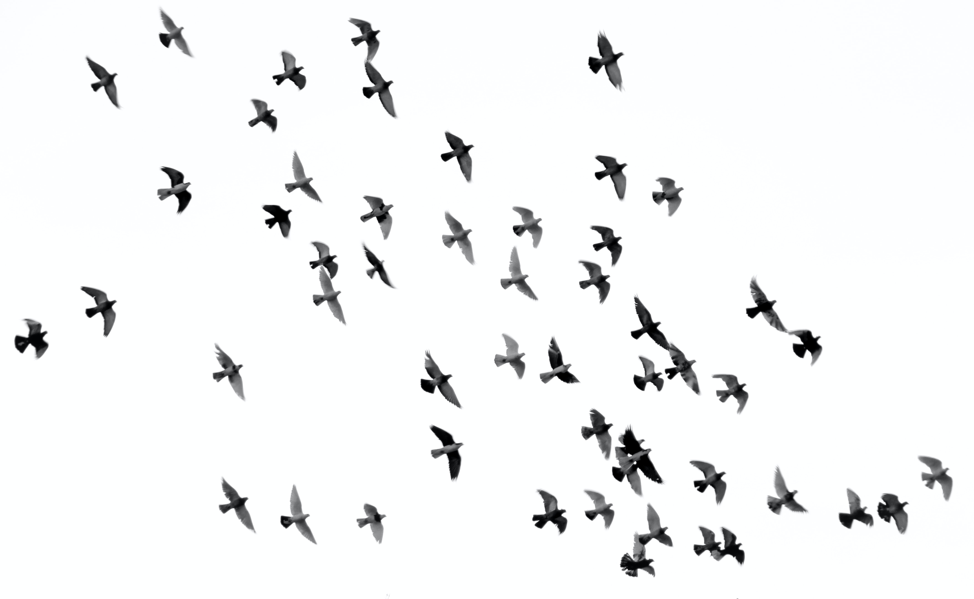
What is flocking?

Slide 5
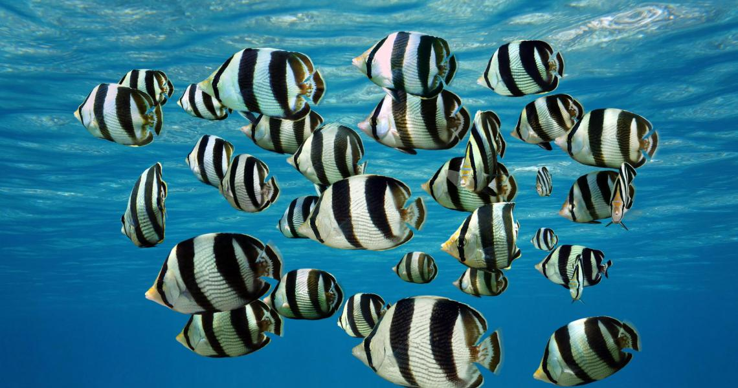
What is flocking?

Slide 6
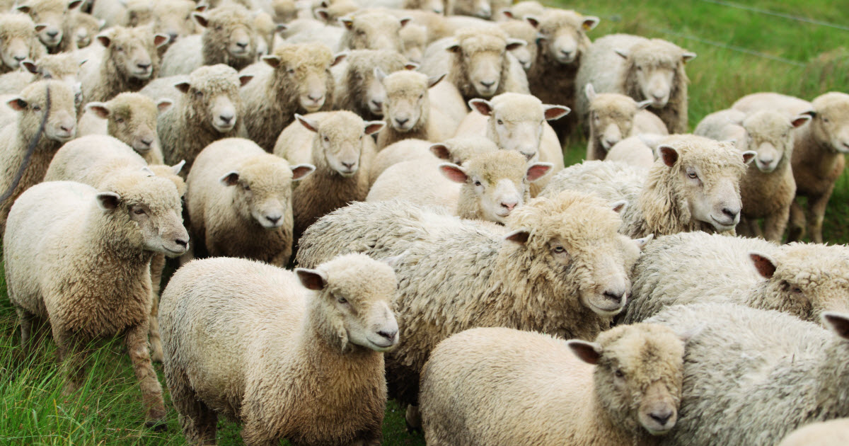
What is flocking?

Slide 7
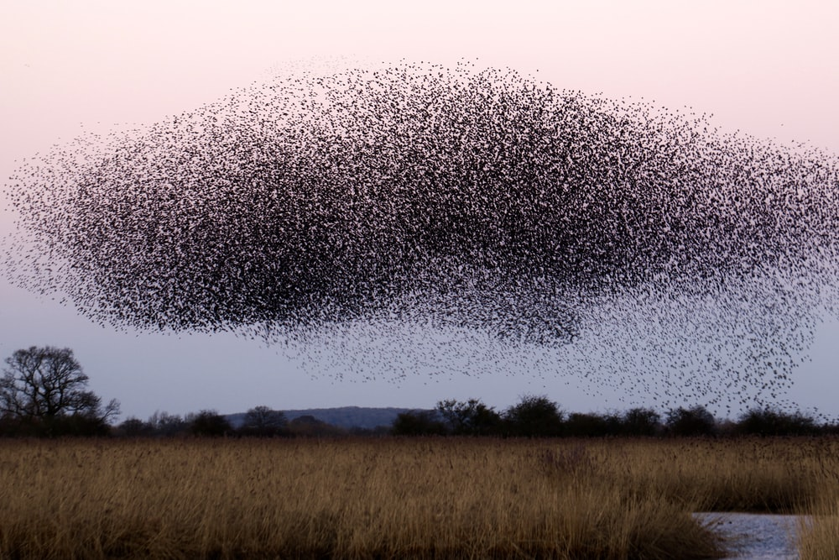
What is flocking?

Slide 8
Basics of Flocking
Proposed by Craig Reynold’s article “Flocks, Herds, and Schools: A Distributed Behavioral Model”
Showcased in the program “Boids”, also developed by Craig Reynolds in 1986
Applies 3 simple rules to members of the flock, called “boids”
Boid is the shortened version of “bird-oid object”

Slide 9
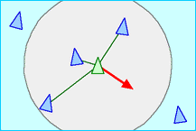
Basics of Flocking: Separation
Each member of the flock tries to stay away from its neighbor members
This rule prevents the boids from colliding with each other

Slide 10
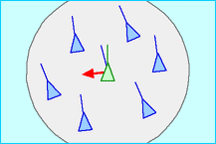
Basics of Flocking: Alignment
Each member of the flock tries to align its velocity with its neighbor members’
This rule makes most of the boids move in a general direction

Slide 11
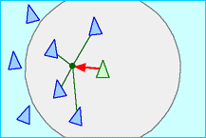
Basics of Flocking: Cohesion
Each member of the flock tries to reach the average position of its neighbors
This rule gathers the boids and keeps them close together

Slide 12
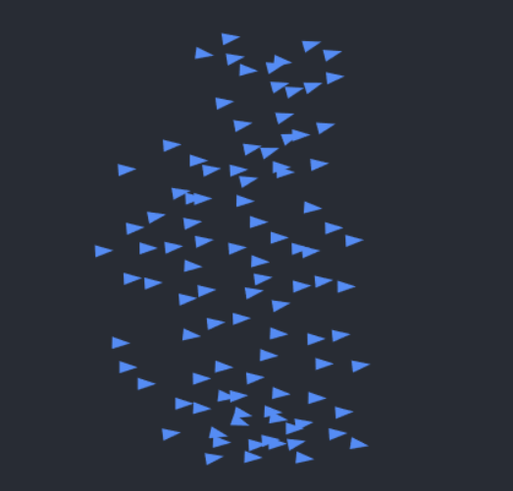
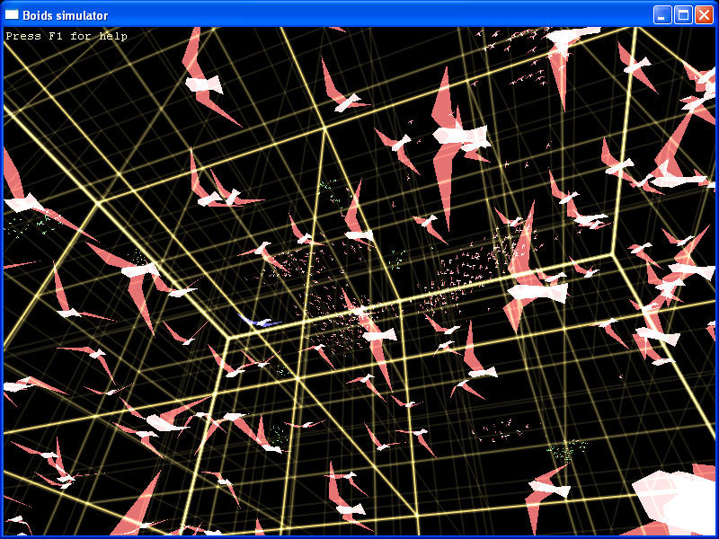
Features of Flocking
Flocking rules can be applied in 2D or 3D space

Slide 13
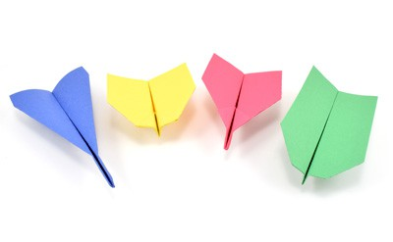
Features of Flocking
Many parameters can control behavior of the flock, such as:
Weight of the ruleset
View radius & angle
Custom velocity for the boid and …
Tweaking these parameters leads to different behaviors

Slide 14
Features of Flocking
Obstacle avoidance and goal seeking
Implementation of different emotions (such as fear, happiness or hunger)
Following a leader, as the original ruleset is leader-less
Random noise in boid movement
Real-world physics (gravity, lift, etc. )

Slide 15
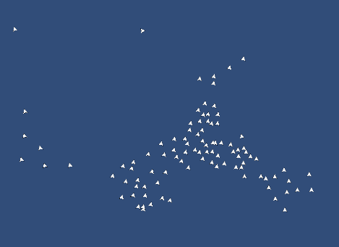
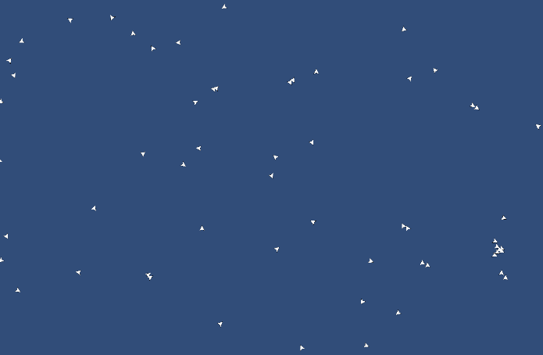
Features of Flocking
Large View Area
Small View Area

Slide 16
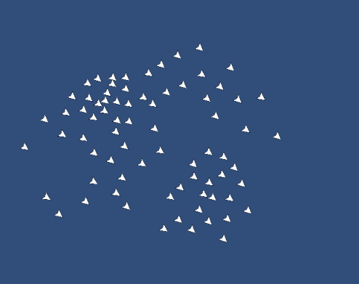
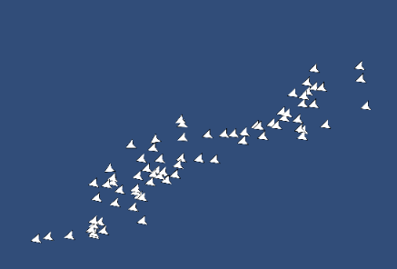
Features of Flocking
Wide View Angle
Narrow View Angle

Slide 17
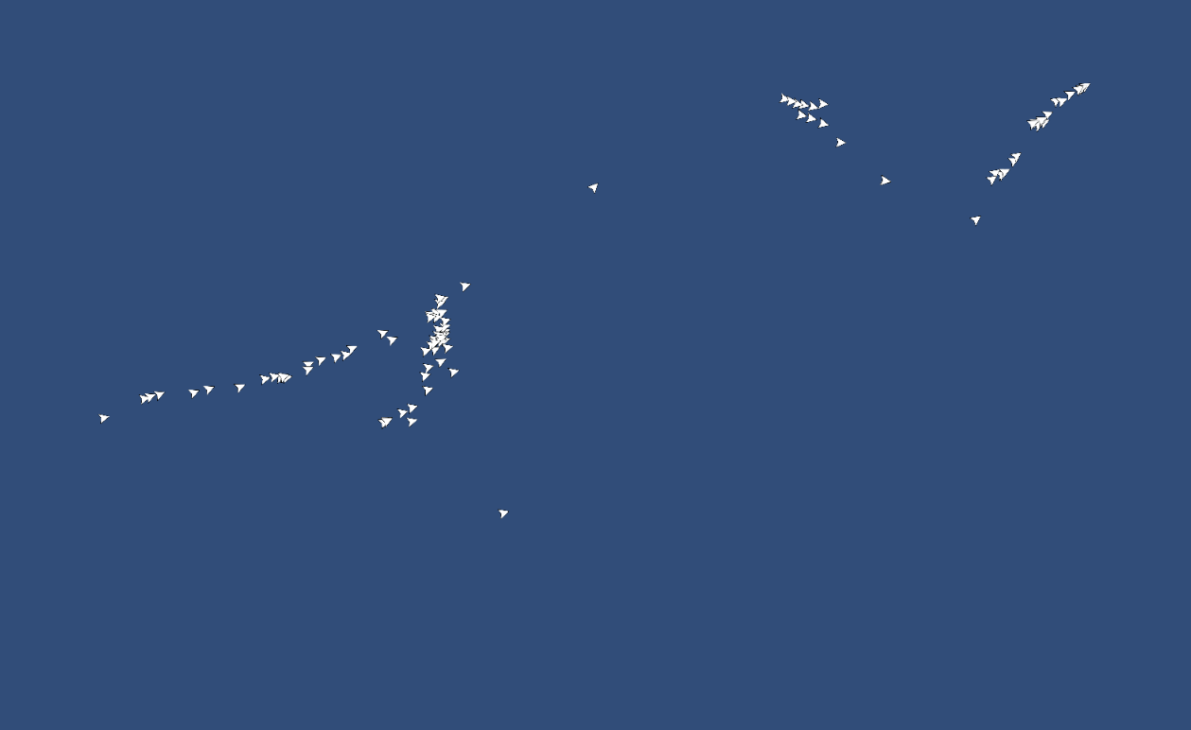
Flocking without Separation rule

Slide 18

Flocking without Alignment rule

Slide 19
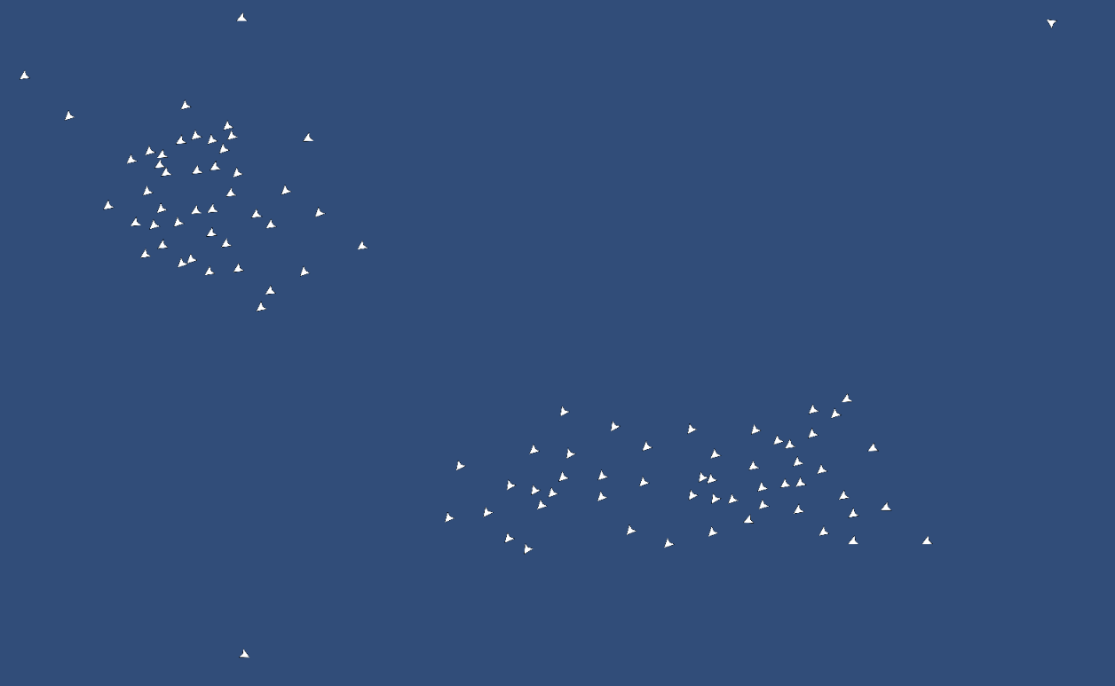
Flocking without Cohesion rule

Slide 20
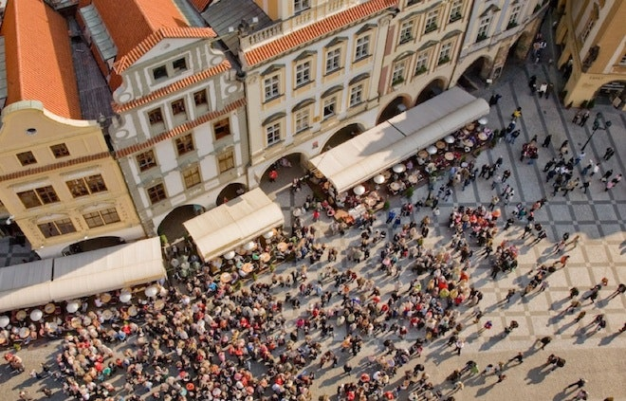
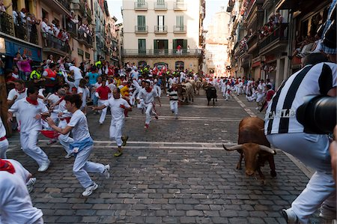
Applications of Flocking
Flocking algorithms are mainly known to simulate and study behavior of birds
However, they can also be used to describe human behaviors
It can model a large crowd gathering at a festival, or running away from danger
May be used in architecture to design buildings providing fast evacuation

Slide 21
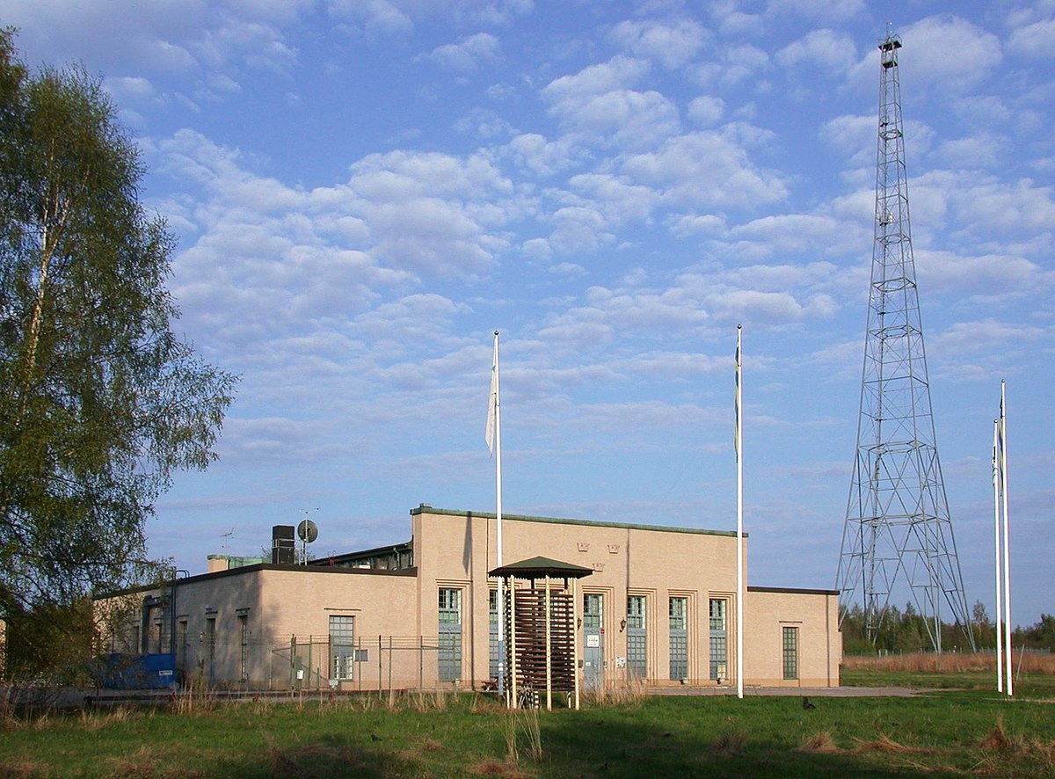
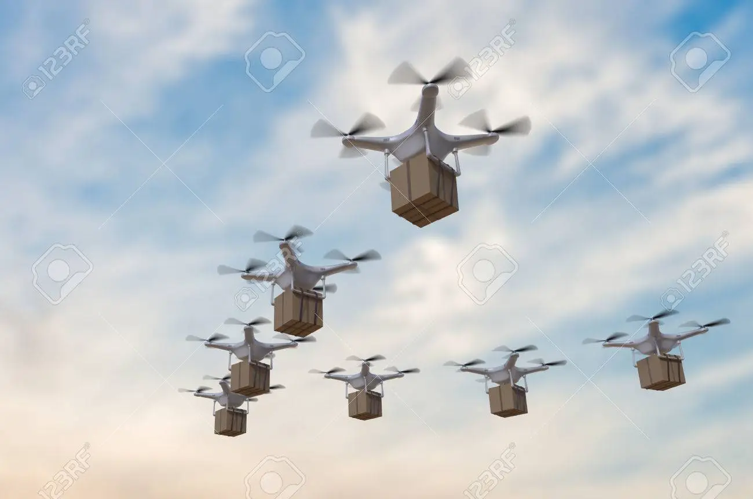
Applications of Flocking
Programming Internet multichannel radio stations automatically
Visualizing time-varying data and querying from live databases
Controlling groups of autonomous flying robots
Simulation of self-propelled particles (SPP)

Slide 22
Applications of Flocking in Media
Flocking can be used to create realistic group of moving entities
It can be used in different types of media
Provides immersion in the scene
Used in animations, movies, and video games
Stanley and Stella in: Breaking the Ice (1987) – the first animation to use flocking

Slide 23

Flying Creatures – Half Life (1998)

Slide 24

Flying bats - Batman BEGINS (2005)

Slide 25

Subnautica (2014)

Slide 26
Thank you!
Fall 00-01

